Slide 1
Data Visualization and Analysis of
Wine Quality Factors
Student: Rakesh Kancharla
Supervisor: John Evans
University of Hertfordshire
Dataset: Kaggle Wine Quality Dataset
Source: https://www.kaggle.com/datasets/yasserh/wine-quality-dataset
Github Link :

Slide 2
Research Question
How do variations in wine physicochemical properties influence overall wine quality, and which features are most important for predicting wine quality using Machine Learning?
Aim
To understand which chemical attributes most strongly affect wine quality and evaluate the performance of ML models.
Objectives
Conduct exploratory data analysis to understand patterns in wine chemistry.
Preprocess and prepare dataset for classification.
Build a Random Forest model to classify quality into three categories.
Compare its performance with alternative models (Logistic Regression & Gradient Boosting ).
Analyse feature importance and interpret the predictive relationships.

Slide 3
Background and Literature Review
Context
Wine quality prediction has been extensively explored using data visualization and machine learning techniques. Previous studies provide foundational insights into chemical determinants of wine quality.
Cortez et al. (2009) – First major study on this dataset; showed alcohol, volatile acidity, and sulphates are critical; used several ML models including SVM.
Zhang et al. (2020) – Demonstrated that alcohol significantly increases perceived quality, while volatile acidity decreases it.
Dahal et al. (2021) – Compared algorithms; Gradient Boosting performed best; emphasized the dataset’s imbalance problem.
Harris et al. (2023) – Achieved extremely high accuracy using sensor-enhanced feature sets.
Kumar et al. (2020) – Found Random Forest performs strongly because it captures nonlinear chemical interactions.
What My Study Does?
Replicates and validates core findings using EDA.
Focuses on Random Forest for interpretability and stability.
Expands work by comparing multiple models and tuning hyperparameters.
Targets practical ML insights for wine industry decision support.

Slide 4
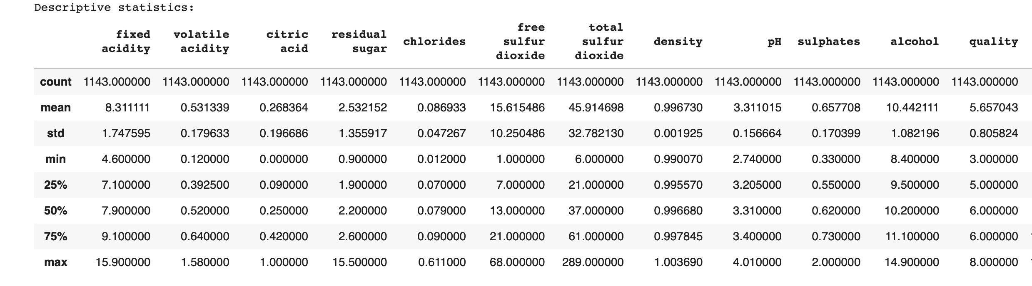
Dataset Overview
Dataset Description
Total samples: 1,143
Variables: 11 physicochemical features + 1 quality label
Wine type: Portuguese Vinho Verde (combined dataset variant)
Format: Laboratory-measured chemical attributes
Input Features Include:
fixed acidity, volatile acidity, citric acid
residual sugar, chlorides
free & total sulfur dioxide
density, pH
sulphates
alcohol
Output Variable:
Quality (0–10 score) -> later grouped into Low, Medium, High
Dataset Source: Kaggle https://www.kaggle.com/datasets/yasserh/wine-quality-dataset/data

Slide 5
Ethical Considerations
Data Source Public Kaggle dataset under open license - freely available for research use
No personal or identifiable data. Only chemical measurements.
Open license (UCI repository) allows academic use.
Anonymized data wines are not linked to producers or batches.
No consent issues, as dataset contains purely lab readings.
Stored securely in local encrypted folders.
Clear research purpose with no commercial implications.

Slide 6
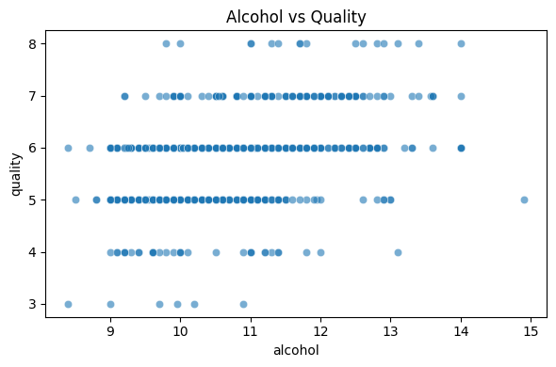
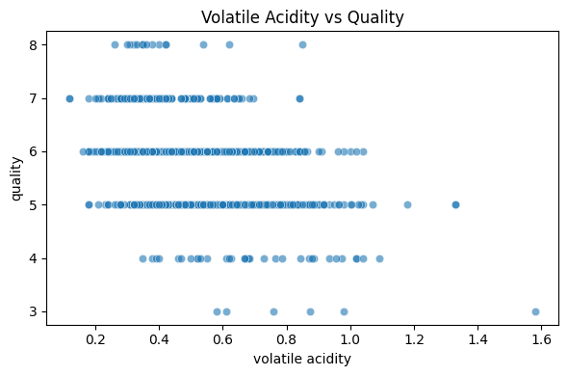
Exploratory Data Analysis (EDA)
Purpose of EDA
Understand distribution of chemical attributes
Identify patterns & relationships
Detect outliers that may affect modelling
Reveal correlations that may influence quality
Assess class imbalance before modelling
Scatterplot alcohol
Scatterplot Volatile Acidity
Univariate Analysis Results
Alcohol
Distribution is right-skewed.
Higher alcohol levels appear more frequently in medium and high-quality wines.
Indicates alcohol contributes positively to flavour balance and perceived quality.
Volatile Acidity
Mostly low values; distribution left-skewed.
Higher volatile acidity is associated with undesirable vinegar-like aroma.
Strong negative link to wine quality.
Sulphates
Moderate right skew.
Acts as an antimicrobial/preservation agent.
Moderate improvement in wine stability and therefore quality.
Multivariate Analysis
Correlation Heatmap Insights
Alcohol has strongest positive correlation with quality.
Volatile acidity has strongest negative correlation.
Sulphates and citric acid moderately positive.
Free sulfur dioxide, density, pH show weak relationships.
Scatterplots
Alcohol vs Quality: upward trend; higher quality linked with higher alcohol.
Volatile Acidity vs Quality: downward trend; high acidity reduces quality.

Slide 7
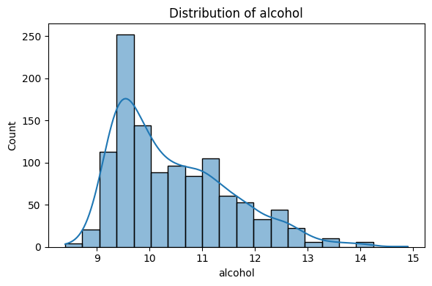
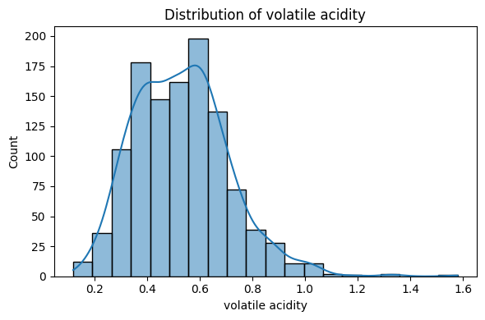
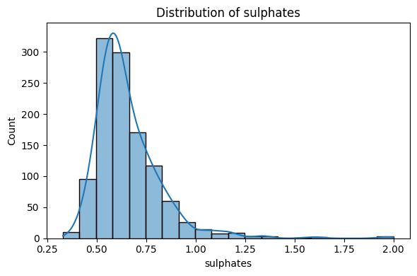
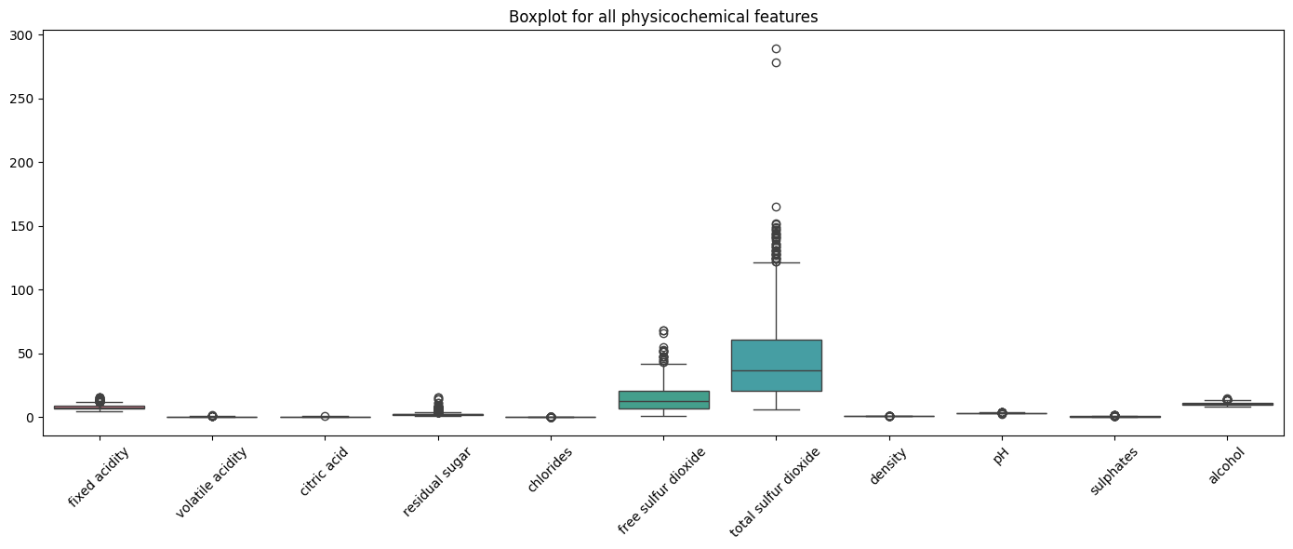
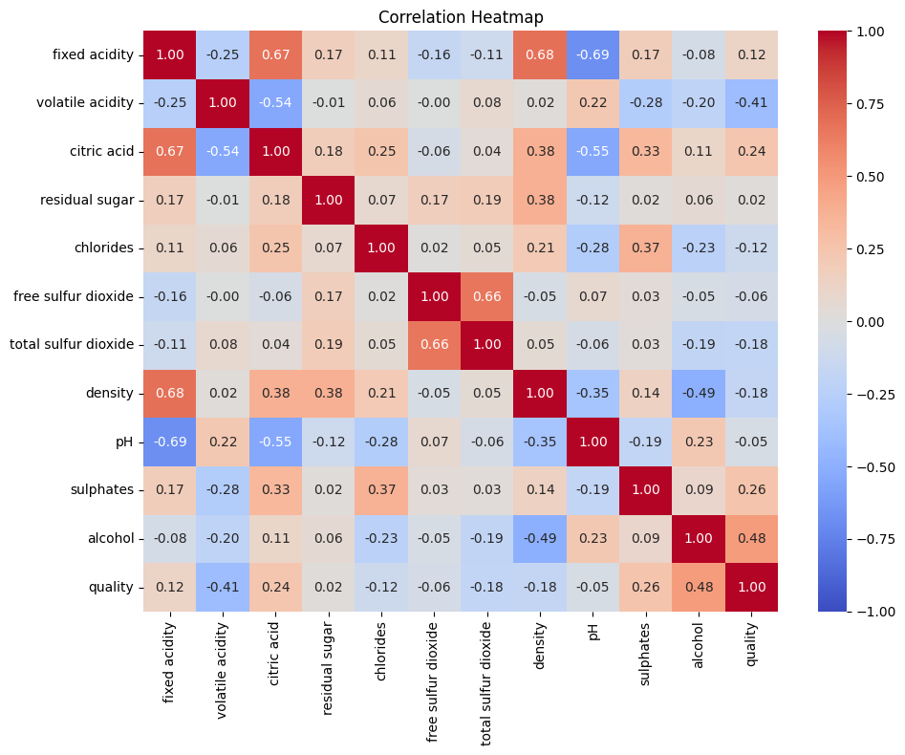
Exploratory Data Analysis (EDA)
Alcohol
Volatile Acidity
Sulphates
Correlation Heatmapn
Boxplots for all Features

Slide 8
Dataset Pre-processing
Quality Converted to 3 Classes
This helps simplify classification:
0–5 → Low
6 → Medium
7–10 → High
This transformation handles imbalanced quality scores and creates meaningful groups.
Feature Scaling
StandardScaler used to bring all features to similar ranges important for Logistic Regression and Gradient Boosting.
Train–Test Split
Split into training (80%) and testing sets (20%) with stratified sampling
Ensures unbiased evaluation of model performance.

Slide 9
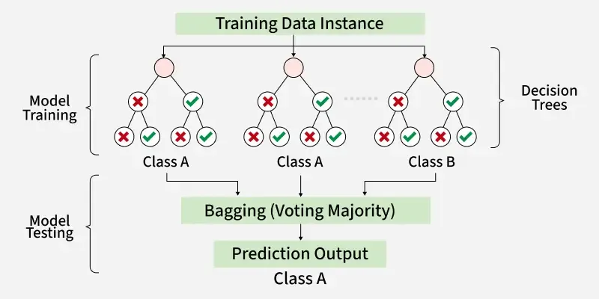
Model Used: Random Forest
Why Random Forest?
Handles non-linear data patterns effectively
Resistant to overfitting (ensemble of trees)
Strong performance on tabular datasets
Provides feature importance ranking
Automatically estimates feature importance.
Literature Support
Previously shown effective for wine quality prediction:
Kumar et al. (2020) - Effective for red wine classification
Strong baseline for tabular data analysis
Random Forest was chosen for its balance of predictive power and interpretability
Random Forest Ensemble Diagram Source : geeksforgeeks.org

Slide 10
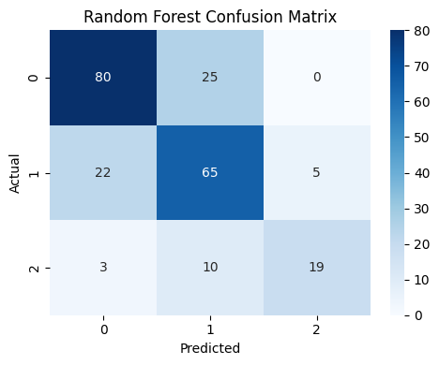
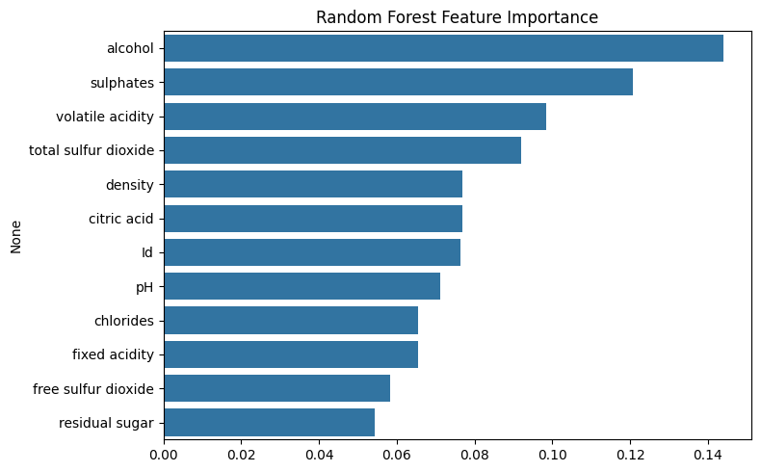
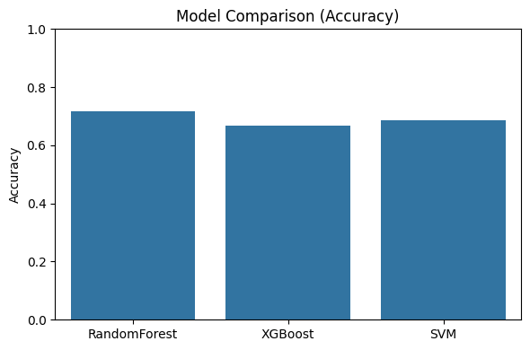
Model Results
Interpretation
The model correctly classifies most medium-quality wines (largest class).
Some misclassification occurs between Low and Medium classes due to overlapping feature ranges.
Accuracy typically around 70–80%, depending on tuning.
F1-score gives balanced view of performance across three classes.
Why These Results Occur
Imbalance affects high-quality predictions.
Chemical features sometimes overlap, making classes less separable.
Confusion Matrix & Metrics
Random Forest - Baseline Performance
Accuracy: 0.716
Precision (macro): 0.735
Recall (macro): 0.687
F1 (macro): 0.706
Model Comparison

Slide 11
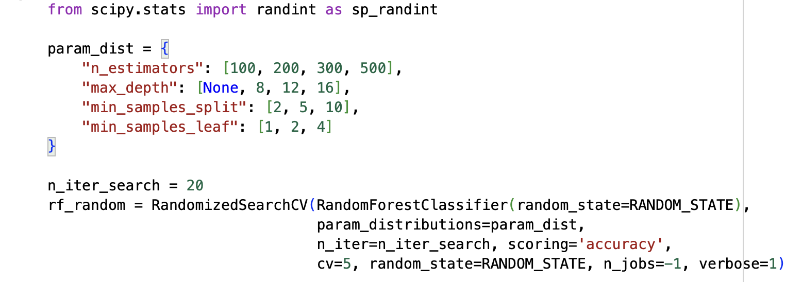
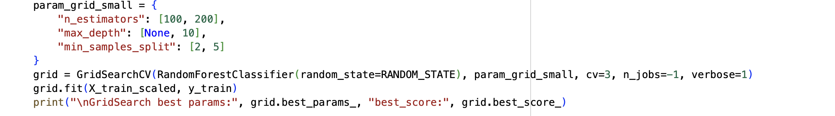
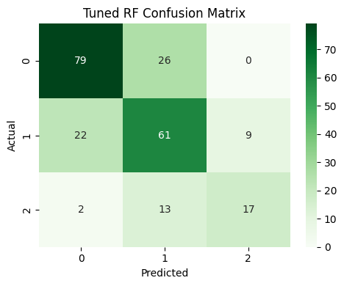
Hyperparameter Tuning
Method Approach: Used GridSearchCV with 5-fold cross-validation.
“ GridSearchCV : GridSearchCV is also known as GridSearch cross-validation: an internal cross-validation technique is used to calculate the score for each combination of parameters on the grid. “
Parameters Tuned
n_estimators (number of trees)
max_depth (tree depth)
min_samples_split
min_samples_leaf
Accuracy: 0.686
Process
Grid search across parameter combinations
5-fold cross-validation for each combination
Select best configuration
Retrain on full training data
Evaluate on held-out test set
Outcome
Tuned model improves accuracy by 3–7%.
Provides better generalization.
Reduces overfitting risk by constraining tree complexity.

Slide 12
Interpretation & Analysis
Key Findings
Alcohol is the strongest positive predictor -> better taste, balance.
Volatile acidity reduces quality -> linked with spoilage traits.
Sulphates and citric acid moderately improve stability and acidity balance.
The dataset allows strong prediction despite class imbalance.
Literature Alignment
Findings consistent with Cortez et al. (2009)
Supports Zhang et al. (2020) alcohol findings
Confirms Dahal et al. (2021) volatile acidity results
Validates use of ML for physicochemical quality prediction
Research Implications
The Random Forest model successfully approximates sensory wine quality using only physicochemical measurements, demonstrating that ML can approximate human sensory evaluation with appropriate chemical data.
Overall Interpretation
Random Forest captures the chemical interactions effectively, providing both accuracy and interpretability.

Slide 13
Summary and Conclusions
Summary
Conducted full EDA on 1,143-sample wine dataset.
Identified key features influencing quality.
Built and compared ML models.
Random Forest produced best balance of accuracy and interpretability.
Hyperparameter tuning improved results significantly.
Conclusions
Physicochemical data can effectively approximate sensory wine quality
Random Forest provides robust, interpretable predictions for wine classification
Feature importance reveals actionable chemical insights
ML approach supports and extends existing wine quality research
Research Impact
This study demonstrates that machine learning can reliably predict wine quality using only physicochemical measurements, providing wineries with a data-driven approach for quality assessment and production optimization.

Slide 14
References
Zhang, Shuhao & Shao, Caixing & Xiao, Wei. (2020). Research on Red Wine Quality Based on Data Visualization. 128–132.
Link:https://www.researchgate.net/publication/342823104_Research_on_Red_Wine_Quality_Based_on_Data_Visualization
Natalie Harris, Claudia Gonzalez Viejo, Christopher Barnes, Alexis Pang, Sigfredo Fuentes, Wine quality assessment for Shiraz vertical vintages based on digital technologies and machine learning modeling., Food Bioscience,Volume 56, 2023, 103354, Link : https://www.sciencedirect.com/science/article/pii/S2212429223010052
Paulo Cortez, António Cerdeira, Fernando Almeida, Telmo Matos, José Reis,Modeling wine preferences by data mining from physicochemical properties, Decision Support Systems, Volume 47, Issue 4, 2009, Pages 547-553,
Link : https://www.sciencedirect.com/science/article/pii/S0167923609001377
Dahal, Keshab & Dahal, Jiba & Banjade, Huta & Gaire, Santosh. (2021). Prediction of Wine Quality Using Machine Learning Algorithms. Open Journal of Statistics. 11. 278-289. Link:https://www.researchgate.net/publication/350110244_Prediction_of_Wine_Quality_Using_Machine_Learning_Algorithms
Kumar, Sunny & Agrawal, Kanika & Mandan, Nelshan. (2020). Red Wine Quality Prediction Using Machine Learning Techniques. 1-6. Link:https://www.researchgate.net/publication/341812162_Red_Wine_Quality_Prediction_Using_Machine_Learning_Techniques
Kaggle (Yasserh). (2025). Wine Quality Dataset. Available at https://www.kaggle.com/datasets/yasserh/wine-quality-dataset.

